Slide 1
Day 5

Slide 2
Objectives
Thread class
Runnable Interface
Thread Methods
Synchronization
Semaphore
Practicing Collection

Slide 3
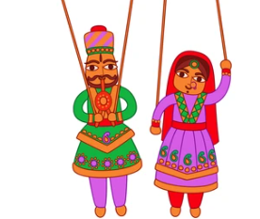
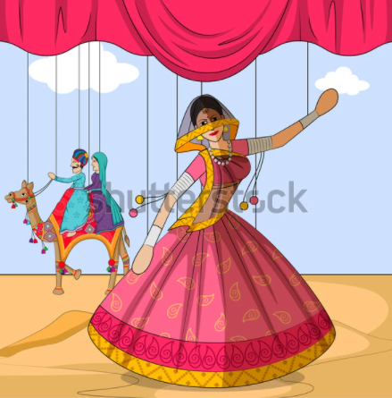
Analogy of Thread

Slide 4
What is Thread?
Let’s Understand thread with Real Time Example
What is Process?
What are Memory allocation?
What are thread?
Example –
Process are like opening MSWord, Music Player, Eclipse
Thread are sub processes which works internally in respective process with same memory allocation and perform it’s purpose.

Slide 5
Thread
What are Java Threads?
A thread is a:
Facility to allow multiple activities within a single process
Thread shares common memory area as of process.
Referred as lightweight process

Slide 6
Multi Threading
Class Main
Main() [It start thread when main method get executed]
This thread is going to follow a set of instruction which we mentioned in code in sequence
Class Main
Main() [It start thread when main method get executed]
Thread1 start executing it’s task
Thread2 start executing it’s task
Thread 3 start executing it’s task
It follows sequence which mentioned in code
T1 –start work
T1 –start work
T1 –start work

Slide 7
Multi Threading
What is multi Tasking?
Process base
Thread Base
(Each process at least having a single thread which start with respective process. Multiple process can be manage by operating system and those system get switching in between as per demand.)when process get started then it will get stack and register to get start.
(Threads also works concurrently . This concurrency can be control by programmer in program)

Slide 8
Multi Threading
Single Thread Process
Multi Thread Process
Code Data File
Code Data File
Register
Register
Register
Register
Stack
Stack
Stack
Stack

Slide 9
Thread Life Cycle
Lifecycle of Thread
States of lifecycle
Newborn State
Runnable(Ready State)
Running State
Blocked State
Dead State (Terminated)

Slide 10
Thread Life Cycle
When we create an instance of class which is extending Thread class is called as thread in New Born state.
Ex.
Class MyThreadClass extends Thread{
Public void run(){
}
}
-----------
Public class Main{
Public static void main(String [] args){
MyThreadClass obj = new MyThreadClass (); // newborn thread
}
}
(Note -> we can use only two methods over here
Start ()-> to take in ready or runnable state
Stop() -> to take in dead state)

Slide 11
Thread Life Cycle
T1 will do it’s work and after finish it will go to in Runnable state back. We can use yield function also to do so
Runnable and Running states
Thread Scheduler start working on it. Thread with more priority or if no priority so on first come first serve basis that thread go in running state
MyClass obj = new MyClass();
New Born Thread
Start()
Running state
Runnable state
T1
T1
T2
T2

Slide 12
Stop
MyClass obj = new MyClass();
New Born Thread
Dead state
Start()
Stop
Running state
Runnable state
T1
T1
T2
T2
Stop
suspend()
resume()
wait()
notify()
sleep()
Blocked / Not Runnable

Slide 13
Thread
Threads in Java
Every java program creates at least one thread [ main() thread ]. Additional threads are created through the Thread constructor or by instantiating classes that extend the Thread class.
Thread creation in Java
Thread implementation in java can be achieved in two ways:
Extending the java.lang.Thread class
Implementing the java.lang.Runnable Interface

Slide 14
Thread
Let’s Understand Thread Hierarchy →
Object Class
Runnable Interface
Methods like start(), stop(), resume(), notify()… are in thread class
Thread Class
Thread Class extends Object implements Runnable
Note –(Runnable is Interface and there is a abstract method in Runnable Interface
Public void run(); . So Whatever code we have to write for a thread we have to write that we have to write in implementation of run() method)

Slide 15
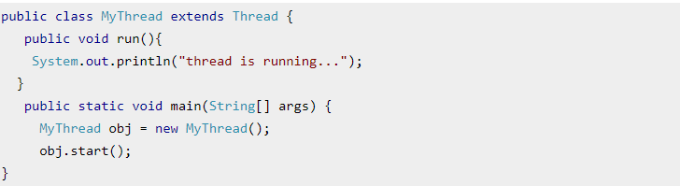
Thread
1) By extending thread class
The class should extend Java Thread class.
The class should override the run() method.
The functionality that is expected by the Thread to be executed is written in the run() method.
void start(): Creates a new thread and makes it runnable.
void run(): The new thread begins its life inside this method.

Slide 16
Thread
Take an Example
Class MyThreadClass extends Threads{
}
Class Main
psv main(){
MyThreadClass obj = new MyThreadClass ();
Obj.start();
(But if we will use run() method directly for this thread then this thread will share stack of main method.)
}
D1
New born Thread
Stack for thread of main method
New stack will be created for thread

Slide 17
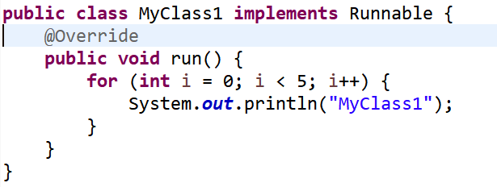
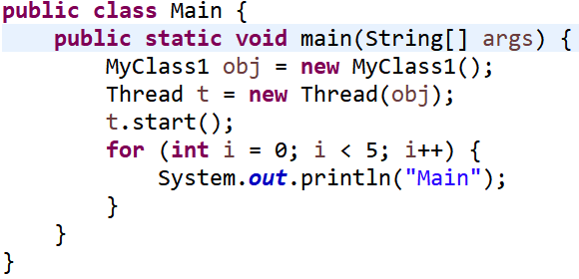
Thread
Implementing Runnable Interface
The class should implements Runnable .
The class should override the run() method.
The functionality that is expected by the Thread to be executed is written in the run() method.
void start(): Creates a new thread and makes it runnable.
void run(): The new thread begins its life inside this method.
D2

Slide 18
Thread
Extends Thread class vs Implements Runnable Interface?
Extending the Thread class will make your class unable to extend other classes, because of the single inheritance feature in JAVA. However, this will give you a simpler code structure. If you implement Runnable, you can gain better object-oriented design and consistency and also avoid the single inheritance problems.
If you just want to achieve basic functionality of a thread you can simply implement Runnable interface and override run() method. But if you want to do something serious with thread object as it has other methods like suspend(), resume(), ..etc which are not available in Runnable interface then you may prefer to extend the Thread class.

Slide 19
Thread
Synchronization of Threads
In many cases concurrently running threads share data and two threads try to do operations on the same variables at the same time. This often results in corrupt data as two threads try to operate on the same data.
A popular solution is to provide some kind of lock primitive. Only one thread can acquire a particular lock at any particular time. This can be achieved by using a keyword “synchronized” .
By using the synchronize only one thread can access the method at a time and a second call will be blocked until the first call returns or wait() is called inside the synchronized method.

Slide 20




Thread
Husband has to transfer 55,000
To his friend
Husband Account has only 1,00,00/-
Wife wants to withdraw 50,000 for shopping
But accidently both of them started their transaction at same time.
D3
Two thread working concurrently. In such kind of condition if there won’t be synchronization then It is not being well working application. So in order to avoid such scenario we will use synchronization

Slide 21
Thread Methods
D4
setName and getName
These methods are use to set name for specific thread in order to identify thread.
thread.setName(“FirstThread”);
getName method use to get name of specific thread
Thread.currentThread.getName();

Slide 22
Methods In Threads
D5
Sleep method in java
The sleep() method of Thread class is used to sleep a thread for the specified amount of time.
public static void sleep(long miliseconds)
This method will ask to add Exception classes to handle Exception handling
If you sleep a thread for the specified time,the thread shedular picks up another thread and so on.

Slide 23
Methods In Threads
D6
setPriority() and getPriority()
We can prioritized threads.
What is the use of synchronization in Java if we have priority methods
Ans → synchronization is needed to avoid race conditions.
even though you have priority assigned to threads, there may be times when two threads of same priority access the resources and final output depends on order in which the resource was accessed.

Slide 24
Methods In Threads
D6
MAXPRIORITY and MINPRIORITY
Purpose of these are same in order to set priority but their values are set.
t1.setPriority(Thread.MAX_PRIORITY);
t2.setPriority(Thread.MIN_PRIORITY);

Slide 25
Methods In Threads
D7
Join()
The join() method waits for a thread to die. In other words, it causes the currently running threads to stop executing until the thread it joins with completes its task.

Slide 26
StringTokenizer in Java
The java.util.StringTokenizer class allows you to break a String into tokens. It is simple way to break a String. It is a legacy class of Java.

Slide 27
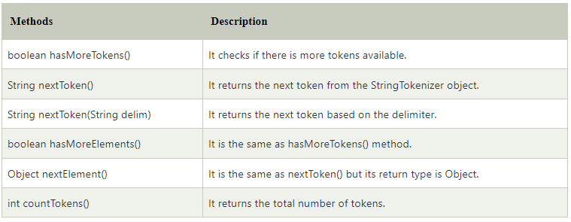
StringTokenizer in Java
D9,10

